Slide 1
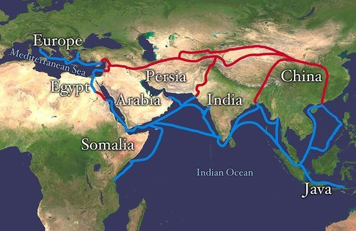
How Do Stories Travel?
The Silk Road—Ancient History Encyclopedia
Notes:
Trade between East & West: silk (prized by Romans), but also horses, gunpowder, slaves--large numbers of goods that had a profound effect on global civilization.
In addition: stories travel, adapting as they go. In my recent book I look at the story of a king who leaves his palace to become an ascetic. Seen thru the prism of Borges, who had a keen interest in traveling stories.
In this talk I’m piecing together some sections of the book that speak to representations of the global circulation of narratives.

Slide 2
Synopsis
How stories travel in space & time
One story: Great Renunciation (king leaving his palace to become an ascetic) seen through the writings of Jorge Luis Borges
Cultural context: Borges as global writer and advocate of global writing
Borges’s interest in Buddhism generally, & the Great Renunciation story particularly
Borges’s essays on Buddhism resonate / are contemporaneous with his essays on the global reach of literature
The Renunciation story as basis for Borges’s “morphological” view of narrative, a method of reading & writing
Why do king-and-ascetic stories travel & endure? What makes them so compelling?
Notes:
Story seen thru Borges & his speculative work on the story; also why this story is so compelling & enduring across time & space.
Building up to the question of why these stories are so powerful? Why they resonate across philosophy, aesthetics, & especially politics

Slide 3
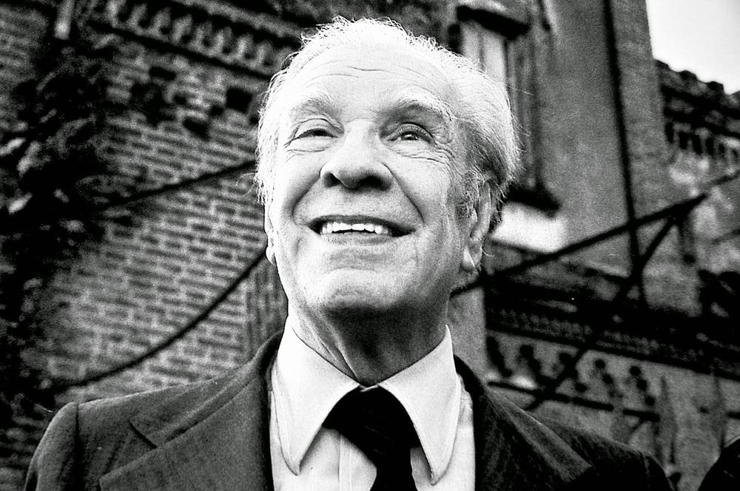
Jorge Luis Borges
Buenos Aires 1899-Geneva 1986
Notes:
Best known fantastic stories from 1940 & 50s, “Library of Babel”, “Funes the Memorious”, “Pierre Menard author of the Quixote” etc.
Founding father of Latin Am “Boom”, influence on Latin Am migrant writers (Julio Cortázar), “magical realism”, global genre of best-selling novels (canonical title: 100 years of solitude), Nobel prize winners (Gabriel García Márquez), spread beyond Latin Am (Salman Rushdie Midnight’s Children on Indian independence)
If Homi Bhabha considers magical realism “lit language of the postcolonial world”, Mariano Siskind goes further still, calling it “global literary currency”
A global writer? Occupies almost entire 20C; move from Buenos Aires to Geneva

Slide 4
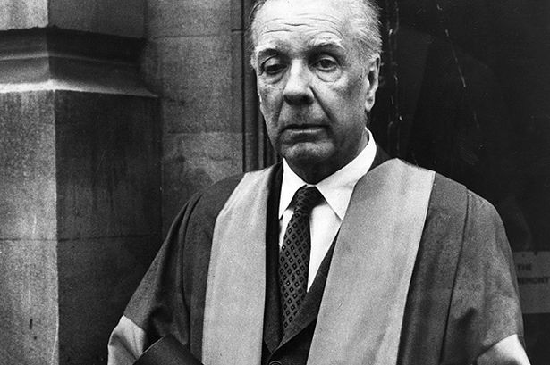
How do Writers Travel? Global Borges
•Bilingual background
•Cosmopolitan & Polyglot
•The role of translation: global fame through translation
•Pascale Casanova The World Republic of Letters: on Paris as the “Greenwich meridian of literature”
•The role of literary prizes: Formentor Prize shared with Samuel Beckett 1961
Notes:
One of the central disciplinary questions in WL: why some writers make it to the global scene, But not others.
Process of globalization: Borges so global today (books, translated), but quite local/peripheral until 50s or 60s.
Consecration thru translation + prizes, process described by Casanova
Casanova on “Greenwich meridian of literature”: translation esp. into French or another major central culture makes an author global.

Slide 5
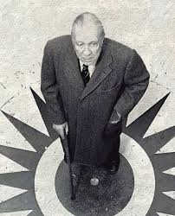
Borges as thinker of global literature:
“The Argentine Writer and Tradition” (1951)
•Against nationalism in culture
•Creative marginality
•Post-colonial vantage point
“I believe that our tradition is the whole of Western culture (…) we must believe that the universe is our birthright and try out every subject”
Notes:
B’s strong “universalist” position
Context: postwar cultural politics in Argentina, Perón strongman, admirer of Mussolini, strong pro-Axis movement during WW2
Country is leaning towards a form of fascism, antisemitism, hyper-nationalism, pressure on writers to write about local themes, gauchos & pampas, Argentine history
≠ Borges in the opposite camp: we can write about anything, No need to limit inspiration to local themes. Shakespeare & Hamlet.
Polemical essay with a broader global reach: manifesto in favor of global, “universal” (beyond “Western”) literature + reclaiming Argentine marginality as a creative advantage (of interest to post-colonial critics today)

Slide 6
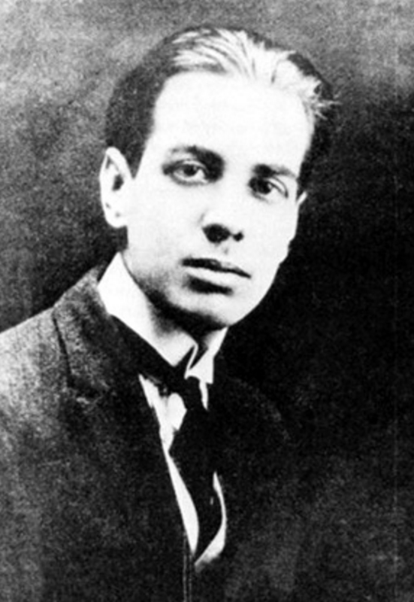
Local vs. Global; Past vs. Modernity:
“The South” (Ficciones)
•Two halves of the nation / two lineages in conflict
•City vs. pampa
•Juan Dahlmann represents modern, urban, immigrant history of Argentina
•Killed by traditional, rural Argentines
•Reader of 1001 Nights
“He was traveling not only into the South but into the past” “This is the death he would have dreamed or chosen”
Notes:
Fictionalization of that argument: Protagonist, JD, recovering from a serious illness, journeys to his estate in the wild Southern provinces of Argentina, where he will eventually meet his end in a knife fight.
Photo of young Borges: Dahlmann alter ego, story interesting to read alongside essay “Argentine writer and tradition”
Both author & character share modern, global outlook on their culture, country; rejected by traditional, rural, xenophobic part of country
Self-portrait: septicemia accident, led to new writing style, fantastic stories, Pierre Menard
Both bookish intellectuals, vicarious dreams of Argentine mythologies, gauchos, manly heroics, bloody death
Share 1001N the ultimate global traveling text
Against this background of B’s strong engagement w/ a transnational aesthetics both in his criticism & fiction, now turn to his engagement w/ Buddhism & Renunciation stories

Slide 7
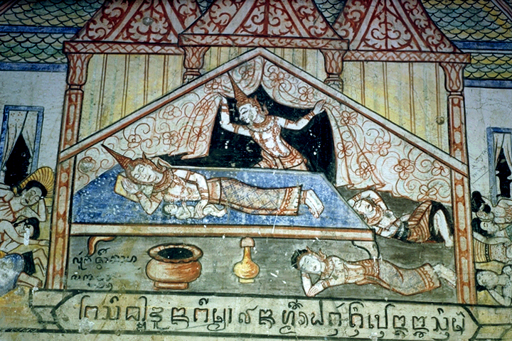
Borges on Buddhism and the Great Renunciation Story:
“Siddharta has found the way”
• Cluster of essays on Buddhism contemporary with the essay on global writing (“The Argentine Writer and Tradition”):
“Personality and the Buddha”
“Forms of a Legend”
“The Dialogues of Ascetic and King”
•Great Renunciation is recalled in each essay
•Compelling story on political, philosophical, metaphysical, literary level
•Global mobility, transcultural circulation of the Renunciation story
On another outing, the last, he sees a monk of the mendicant orders who desires neither to live nor to die. Peace is on his face; Siddharta has found the way” (“Forms of a Legend”)
Notes:
Lifelong interest in Buddhism as philosophy. (first essay 1922, + Later short compilation 1976 Qué es el budismo?; “Buddhism” in Seven Nights)
However, Cluster of essays on Buddhism in early 50s specially interesting because they link to key aesthetic & political questions Significantly, in these essays Borges’s focus is on global mobility, adaptation, transmission, transformation of the Renunciation story.
Picture + context: 29 years of Secluded life; 4 encounters; departure from palace

Slide 8
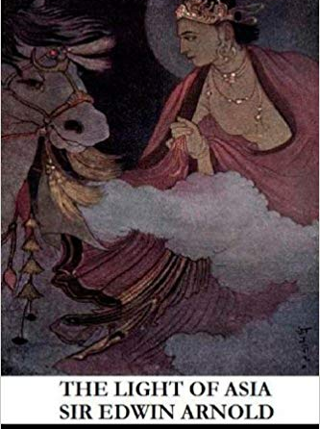
Borgesian Sources: 19th-20th century European interpretations
Sir Edwin Arnold, The Light of Asia, or, The Great Renunciation (1879)
•First encounter with Buddhism in childhood
•Best-selling poem of the Buddha’s life
•Key episode: the Great Renunciation
•Awareness of transcultural circulation
I will not have that crown
Which may be mine: I lay aside those realms
Which wait the gleaming of my naked sword
***
For now the hour is come when I should quit
This golden prison, where my heart lives caged,
To find the truth; which henceforth I will seek
For all men’s sake, until the truth be found.
(Book the Fourth: The Great Renunciation)
Notes:
Sources: Extensive reading & quoting of mostly 19-20C scholarly sources, Rhys Davids, Max Müller Sacred Books of the East, Hermann Oldenberg, Britannica 1911…
(NB. ≠ Later book 1976 refers to more recent scholars Suzuki, Conze)
Light first read as a child, made a profound impression on Borges. An example of poetic recreation of Buddha story: retelling of B’s life in long romantic narrative poem, best-seller, still in print, widely read
NB. Orientalist illustration of scene of Siddharta leaving palace: resembles Edmund Dulac or Léon Carré’s illustrations for 1001N
19C European understanding of Buddhism gives prominence & centrality to the GR episode, becomes defining story of Buddhism
Also attention to transcultural adaptability of legend, in the context of scholarly focus on comparative mythology
GR story of political significance & literary importance for Borges

Slide 9
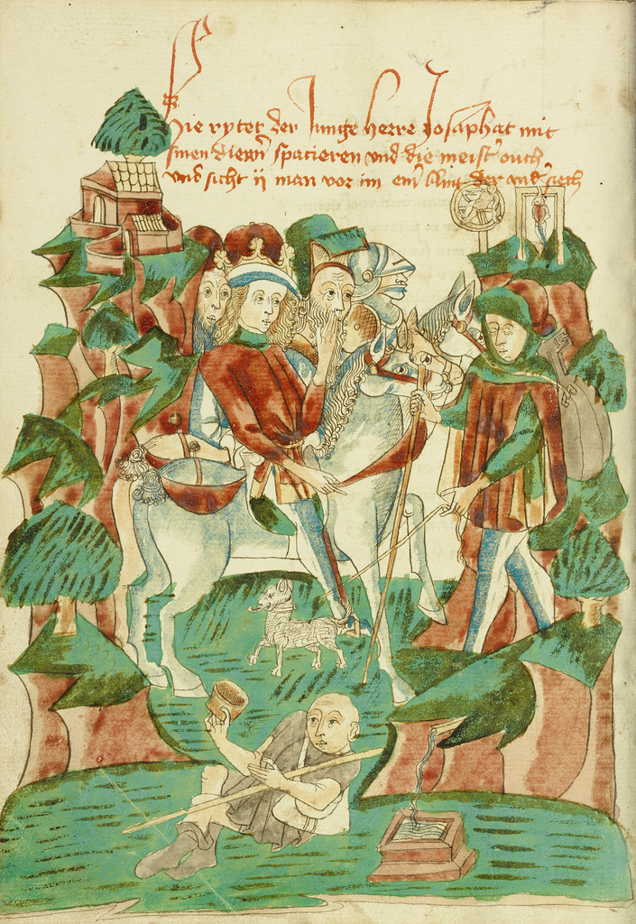
Global Circulation of the Legend
“Forms of a Legend”:
“Reality may be too complex for oral transmission; legends recreate it in a way that is only accidentally false and which permits it to travel through the world from mouth to mouth”
•Book of Bilawar and Budasaf (Islamic retelling, 8th century Baghdad)
•Barlaam and Josaphat (Christian, various medieval sources)
•Barlaam’s Saga (Old Norse, 13th century)
•Oscar Wilde, “The Happy Prince”
Prince Josaphat Meets a Blind Beggar
Alsace, 1469; Getty Museum
Notes:
Object of B’s inquiry: legend of Buddha. Is “a legend” which takes many “forms”. Large number of texts in various lggs. Essay stresses the link bw the legendary & the global. Focus on global mobility, transmission, adaptation, transformation.
Ex of adaptation to local characteristics! Name: Boddhisattva, Budasaf, Josaphat; religion: king idolater who persecutes people, addition of teachers Bilawar, Barlaam monk
Essay traces the legend’s global movement from East to west: Borges gives an elegantly streamlined version of the story’s circulation in space (from India to Iceland) & time (from the Jataka tales to the medieval Golden Legend & Oscar Wilde’s late 19C children’s story)
From notion of traveling legend B moves to notion of archetype (basic component of story) in 2nd essay

Slide 10
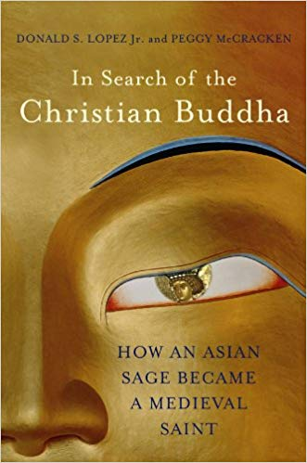
Archetypes and Circulation
•“Forms of a legend” on the global circulation of the Buddha legend
•“The Dialogues of Ascetic and King” on global variants of archetypal stories
•Renunciation story as a model for literary composition & circulation
•A basic story about power and powerlessness
Notes:
I want to mention a recent & very useful book Lopez & McCracken (2014): trace traveling story of Buddha thru Buddhist, Muslim & Christian lands. Contemporary take on global circulation of stories: Ask not only “how stories circulate among religions but also how religions circulate among stories”. Read together with B’s essays: corroborate much of the material / have a different scholarly focus.
Together Borges’s essays (published a year apart) cover range of issues on global reach of a traveling story.
Buddha story captures B’s imagination as traveling story: from East to W. Parables: Bilawar/Barlaam as merchant selling healing stone, emblematic of traveling stories along trade routes. Cf. numerous Borges parable-like stories involving stones/stories troped as stones.
Transcultural mobility + archetypal awareness together form terrain for Borgesian aesthetics of morphology, ie model for literature.

Slide 11
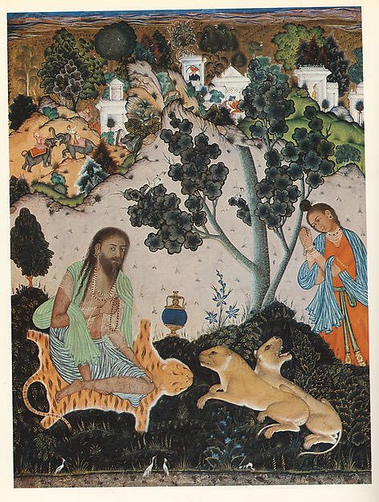
The Archetypal Confrontation of King and Ascetic
“A king is a plenitude, an ascetic is nothing or wants to be nothing, and so people enjoy imagining a dialogue between these two archetypes” (“The Dialogues of Ascetic and King”)
Notes:
Second essay “K&A” introduces notion of “archetype”. Beginning sentence.
“Here are a few examples, from Eastern and Western sources”: focus on enduring recognizable pattern (archetype), & its global variations.
Iconographic evidence of the transcultural recurrence of the motif & enduring power of the story of kingly renunciation resulting from dialogue with ascetic

Slide 12
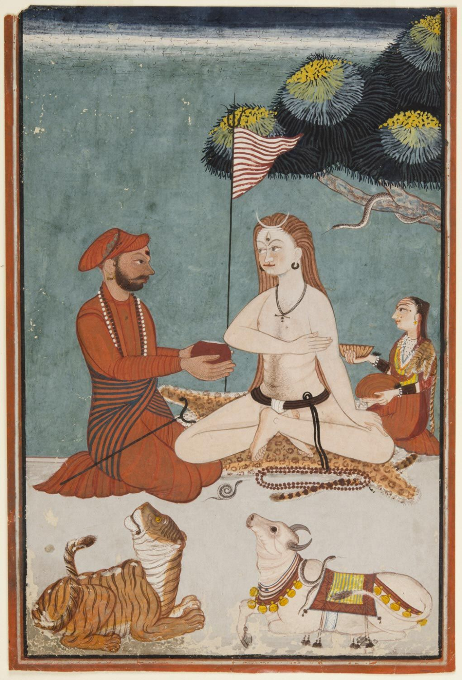
Kings and Ascetics Worldwide
Examples of transcultural variations: Greek, Indian, Chinese, Scandinavian, Egyptian…
“In the stories I have mentioned, the ascetic and the king symbolize nothing and plenitude, zero and infinity” (“The Dialogues of Ascetic and King”)
Notes:
B’s essay lists many examples of transcultural variations: (Heraclitus & Darius, Diogenes & Alexander, Milinda & Nagasena, various Chinese versions, emperor’s dream in The Dream of the Red Chamber…)
Widest possible circulation ≠ at the same time, opposite movement: reduction of the story to its basic equation

Slide 13
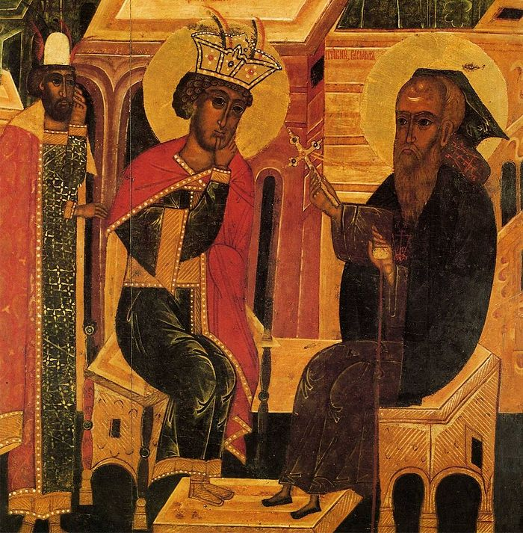
Patterns, Repetitions, Morphology
“These texts, scattered in time and space, suggest the possibility of a morphology (to use Goethe’s word) or science of the fundamental forms of literature”
“Perhaps universal history is the history of the diverse intonation of a few metaphors” (“Pascal’s sphere”, 1951)
All possible stories are “virtually inexhaustible repetitions, versions, perversions” of a few archetypes (“Biography of Tadeo Isidoro Cruz, 1829-1874”)
Notes:
Conclusion to “Ascetic & King” speculates on a morphological conception of literature.
Idea repeated in other essays, stories
Introduces reference to Goethe & goethean notion of morphology—why?

Slide 14
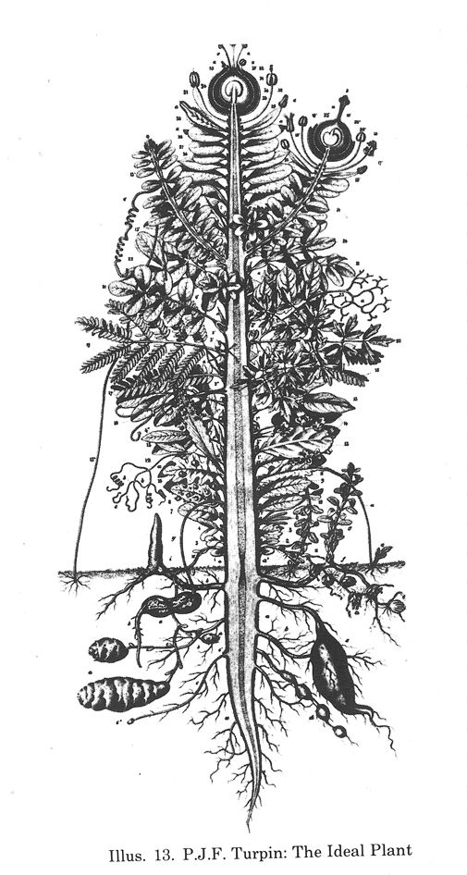
Goethe’s Morphology & the hypothesis of a “science of the fundamental forms of literature”
•Goethe’s Morphology of Plants and the basic archetypal model of plants
•Infinite diversity stems from a few common archetypes
•Metaphorically extrapolated: basic metaphors, archetypal story forms
“I have occasionally speculated (…) that all metaphors are variants of a small number of archetypes; perhaps this proposition is also applicable to fables” (Dialogues of Ascetic and King”)
Turpin’s 1837 rendition of the Urpflanze
Notes:
NB. Goethe better known to lit scholars for his notion of Weltliteratur, but was also a scientist.
Morphology notion central to Goethe’s botanical work.
Urpflanze: Ideal, archetypal plant from which plant diversity stems: “With this model (…) an infinite number of add’l plants can be invented” (1787, to Herder)
Metaphoric extension to culture, not by Goethe himself but others
“Dialogues of kings and ascetics”: suggest the possibility of a morphology: B’s speculations on story of Buddhism intertwined with reflections on literature as infinite variations on finite number of basic modules, whether metaphors or plots.
Metaphors & fables: generate all possible poems, stories: theory of poetry & narrative (speculated only: characteristically tentative, reticent)

Slide 15
Morphological Thinking,
From Botany to Literature
•Oswald Spengler Decline of the West: Outlines of a Morphological World History (1918)
•Russian Formalism: poetry as re-disposition of images (V. Shklovsky, “Art as Technique”, 1917)
•Vladimir Propp, Morphology of the Folktale
•André Jolles, Einfache Formen [Simple Forms] (1930)
•Mircea Eliade, The Myth of Eternal Return (1954)
•Gérard Genette, Palimpsests (1982)
Notes:
20C revival of Goethe’s morphological thinking; attempts to adapt biological models to historiography, lit theory, anthropology… Propp’s modular conception of folk tales, Eliade’s theory of archetypes all indebted to Goethe & most likely known to Borges
Structuralists & post-structuralists (Genette, Todorov) bring together Formalists & Borges’s morphological ideas: key place for Borges in the history of Structuralism.
Helpful to remember Said’s essay “Traveling theory” (on how a theory changes shape & significance as it travels): here not about a traveling theory but a traveling “form” (composite of trope & idea)
Also, Borgesian “morphology” focused on recurrence of archetype, leads directly to praxis (rather than theory) of reading & writing

Slide 16
Morphology as Compositional Method and Reading Protocol
“The Mirror and the Mask”
Transmigration and circulation of fables and metaphors
“Parable of the Palace”
“The Dialogues of Ascetic and King”: Milinda & Nagasena, Diogenes & Alexander
“The Two Kings and the Two Labyrinths”
“Forms of a Legend”: Renunciation story East to West
Renunciation Archetype (King Leaving the Palace)
Notes:
Borges focuses on pattern recurrence & sameness (≠Lopez & McCracken focus on what changes in the legend when it travels into a different cultural environment)
Morphological pattern of archetype-and-variation.
-Reading protocol: focus on plot, not character
-Compositional method: accidental variants of archetypal plot & transcultural variants of renunciation story (Islamic world, China, Celtic story) where each time, king confronts ascetic/poet antagonist
Reading entails process of abstraction (multiplicity to unity) ≠ writing process of expansion (unity to multiplicity)

Slide 17
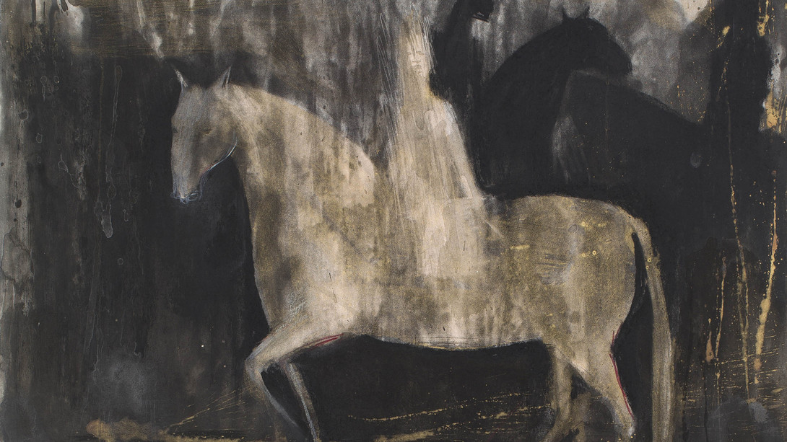
Why renunciation? Why do king-and-ascetic stories endure and circulate? The power of story
A Spiritual paradigm
•Geoffrey Galt Harpham, The Ascetic Imperative in Culture and Criticism (1987)
“transcultural impetus toward asceticism” “a primary transcultural structuring
force”
•“A community of imitation”:
conversion through
storytelling
Legend leads to conversion
Deborah Bell, “Renunciation”, 2014, Johannesburg
Notes:
R Story endures & travels because asceticism has transcultural appeal across different religions
Useful to my own book: Harpham’s study of (primarily X) asceticism as transcultural force, following Durkheim, asceticism as elementary form of every religion
Also helpful: Harpham’s analysis of “communities of imitation”: Imitative chains of Western asceticism: renunciation as a result of reading renunciation stories: interfaces with Borges’s reflections on traveling legends.

Slide 18
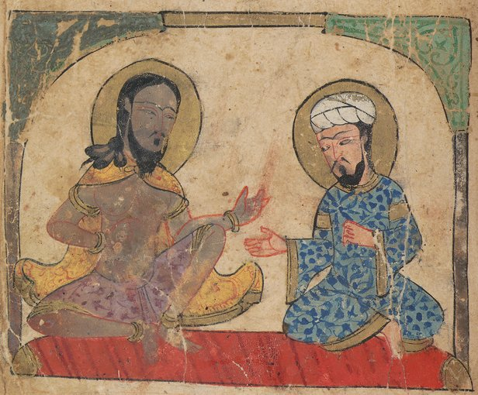
Political Appeal: the king-and-ascetic story as a lesson for the king
A Political paradigm
•Paradox: the powerless wins over the powerful
•Paradox: a story about renouncing power has political power
•Power, Powerlessness, and Truth
Kalila wa-Dimna, Egypt, 14th century
Notes:
Not limited to religious context: carries political message
Captures imagination because it is highly paradoxical: powerless opponent wins; story about renouncing power yet carries political power
Renunciation can be framed in terms of an apolitical response to political violence, injustice, impermanence
But can also be Framed in terms of truth-seeking & truth-telling, bc the confrontation bw ascetic & king can be abstracted into an opposition bw power & truth: hence the possibility of the ascetic’s agency over the king
Borges’s speculations on King-and-ascetic dialogues interface with contemporary debates in political philosophy

Slide 19
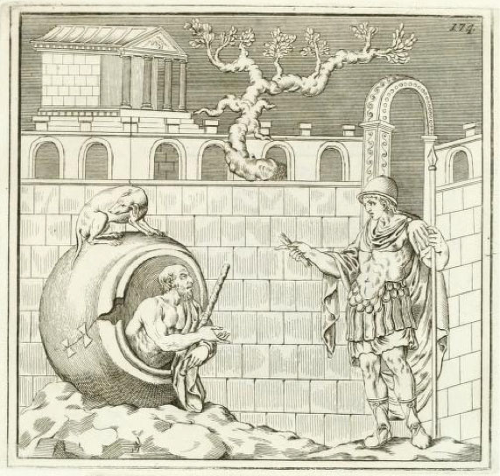
Alexander and Diogenes: “a secret kinship”
“Alexander told his courtiers that had he not been Alexander, he would have liked to have been Diogenes”
18th century Stosch Collection
Notes:
First ex in B’s essay on K&A: Greek variant: Cynic, philosophical radicalism, less a doctrine than a way of life
Iconic scene here Alexander (King, emperor, plenitude, power) vs. Diogenes (ascetic, has nothing, epitome of powerlessness)—but paradoxically has the upper hand in the confrontation.
Unwashed, naked, tub, dog (etymological root of Cynic): No desire: get out of my sunshine.
Contemporary revival of philosophical interest in Cynics, eg Peter Sloterdijk’s Critique of Cynical Reason [1983], 1987: definition of philosophical wisdom as the rejection of the principle of power. “Diogenes’ answer negates not only the desire for power but the power of desire as such”.

Slide 20
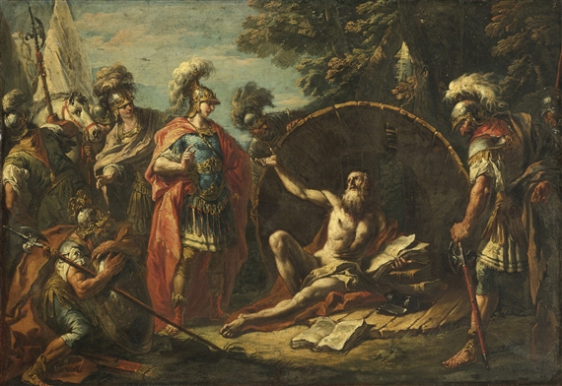
Renunciation and Parrhesia
•The renouncer as
Intellectual
•Speaking Truth to
Power
•Ascetics as Parrhesiastes
•Foucault on Cynics, Parrhesia, and Modern Renouncers (The Courage of Truth, 2011)
•Foucault & Borges: Borgesian text on Chinese encyclopedia at the origin of The Order of Things (1970)
Gaspare Diziani, Alexander and Diogenes (1740)
Notes:
In this picture by Baroque Venetian painter Diziani, note Classical posture, reminiscent of Christian ascetic & scholar, Saint Anthony and/or Saint Jerome. Corroborated by presence of books ≠ Diogenes not a reader. Here intellectual renouncer.
In the book I found it helpful to relate B’s specualtions on K&A to Foucault’s late work on cynics & asceticism, & modern-day intellectuals & artists.
Also interesting that B was a seminal reference for Foucault’s early work, quotes passage on fictional Chinese encyclopedia as the seed idea for The Order of Things
Why are ascetics of interest to the philosopher of power?
Parrhesia: ascetics good parrhesiastes
Borges’s implication in the politics of the confrontation: how can he speak truth to power?

Slide 21
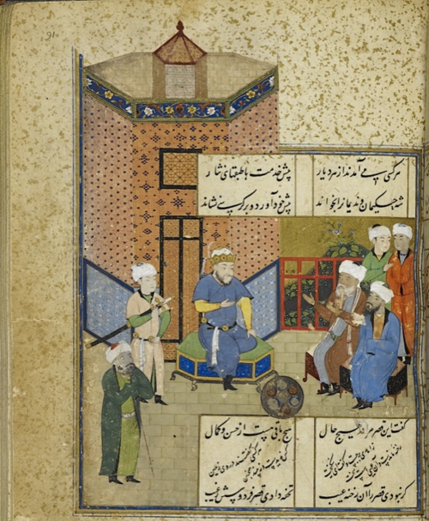
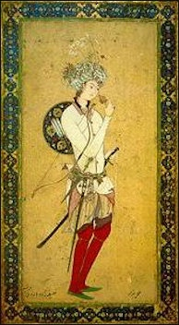
Storytelling and Parrhesia
•Generic kinship: Mirror for Princes
•Fables as teaching stories for kings
•The prince-in-disguise archetype as variant of renunciation story
Caliph Harun al-Rashid, Bagdad 786-809
Notes:
Teaching story, its purpose is to act on king’s behavior
Instruct king or prince. Mitigate despotic behavior. Enlighten ruler through narrative, edutainment
Storytelling as an Eastern counterpart to Greek parrhesia (Jennifer London’s work on political use of fables)
Renunciation stories as exemplary stories to instruct king or despot
2Calcutta edition of Nights (Burton, Mardrus): cluster of hermit stories elicit expression of regret from Shahryar for his murderous behavior
Explored in the book: prince in disguise archetype as variant of renunciation story, temporary outing from palace leads to betterment of king
Legendary setting: Harun al-Rashid sets out from his palace in disguise, encounters adventures in his city, rights wrongs. Variant: Renunciation is a temporary “exercise” (in Foucauld’s sense of the word)

Slide 22
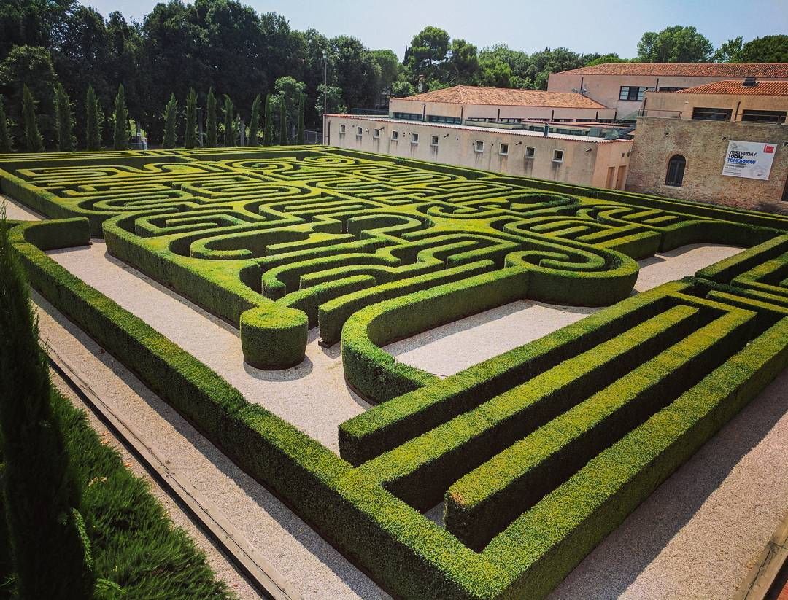
The Borges Maze, Randall Coates
Cini Foundation Library
“Infinite stories, infinitely branching” (“An Examination of the Works of Herbert Quain”, Fictions)
Notes:
I leave you with the Borgesian maze of stories traveling & branching off into multiple variants
Also leave you with a question that speaks to the political dimension of K&A stories: Renunciation stories political or apolitical in their message?
Borgesian ambiguity: on one hand, recurrence of recognizable, repeated patterns makes Renunciation story endlessly & globally relevant
But, on the other hand, B’s morphological approach means that specifics of time & place (historical/geographical accidents) erased in favor of abstract oppositions & timeless patterns
Stories of kings & ascetics good to think with (as are B’s variations on them) bc although they steer clear of direct political discourse, they resonate powerfully in times of crisis.
As Hannah Arendt said (who wrote about the political power of storytelling) perhaps we need stories to think poetically in dark times.

Slide 23
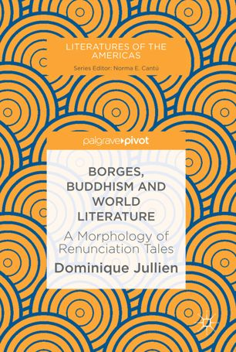
For more on this see my book:
Dominique Jullien
Borges, Buddhism and World Literature:
A Morphology of Renunciation Tales
(London: Palgrave Macmillan, 2019)

