Slide 1
limitations of the so-called “87 regime” in south KOREA
Global Studies Colloquium Series, UC Santa Barbara (June 5th, 2019)
Jin-Ho Jang
Ph.D. in Sociology
(Gwangju Institute of Science and Technology, South Korea)

Slide 2
1. What is a (HISTORICAL) REGIME here? 사시대의 자연에 대한 태도와 신화적 자연관
■ Definition
- conceptual construction of historical periods , each of which is politically and socio-economically differentiated from earlier and later ones in terms of the features of government and political rule, economic policies and institutionalization, or/and societal atmosphere
■ Charateristics
- some characteristics and traces of earlier regimes still remain in later ones. i.e. it is not the case that the following regimes entirely replaces the previous ones with no remnant. (e.g. anti-communism in ‘53 & 61 regimes’ → anti-leftism in [post-] ‘87 regimes’)
- some of constitutive aspects of earlier regimes are shown in later ones in changed forms and ways. (e.g. developmentalism in ‘61 regime’ → neoliberalism in ‘97 regime’)

Slide 3
2. (HISTORICAL) REGIMES OF MODERN SOUTH KOREA
Regime | Incidents | Characteristics
53 Regime | Korea War (1950~3) → Truce(1953) | Consolidation of right-wing; anti-communist regime
61 Regime | Park Chung-hee’s coup and rule (1961~79) | Developmental authoritarianism; anti-communist military regime
87 Regime | June Democratization Movement + Great Workers’ Struggles (1987) resulitng in Constitutional reform (1987) | Transition to and consolidation of political democracy; post-military conservative hegemony
97 Regime | Financial crisis (1997); liberal political party’s rule (1998~2007) | Blossoming of liberal democracy, deepening socio-economic neoliberalism; South-North Korean dialogues/détente
2008 Regime | Conservative political party’s rule (2008~2016) | Rebirth of political authoritarianism; South-North Korean conflicts and confrontations

Slide 4
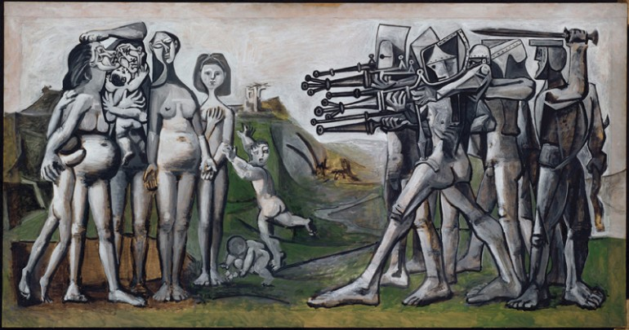
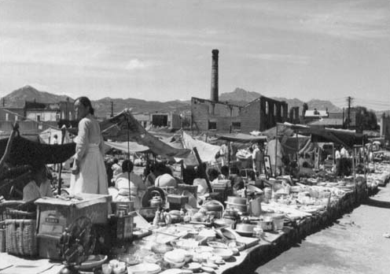
3. HISTORICAL REGIMES OF MODERN SOUTH KOREA <53 regime> - origins of Anti-Communism in south korea and the global Cold War - establishment of the national-division system
Massacre in Korea (1951) by Pablo Picasso
Korean War (1950-53), the first international hot war
leading to the global Cold War (1950s-80s)

Slide 5
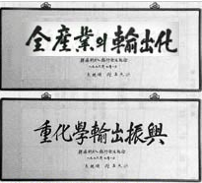
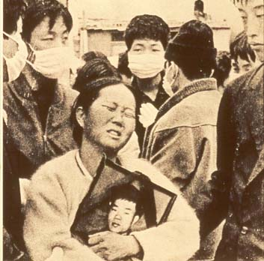
<61 regime> 화적-Developmental authoritarianism and the seeds of labor activism in south korea 자연관
Park Chung-hee's writings
(“exporting from all industries”;
“Promotion of HCI exports”)
Chun Tae-Il self-immolated saying “We are not machines!” for improving workers’ rights (1970).
General Park Chung-hee (front)
In a military coup in May 16th, 1961

Slide 6
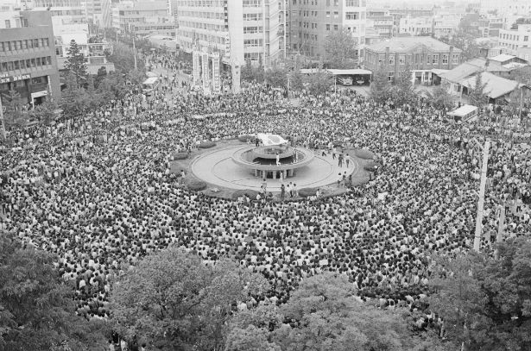
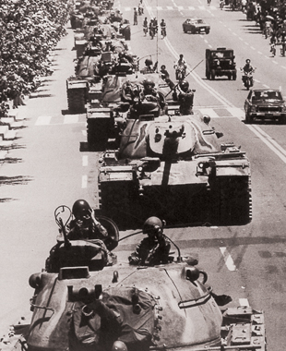
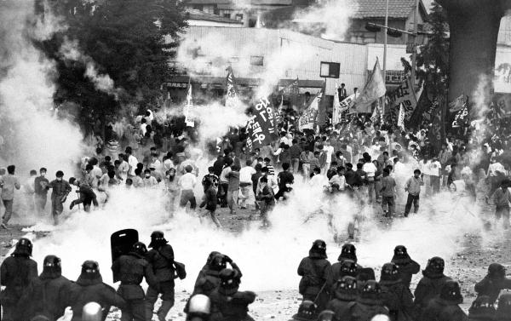
<87 regime> - park chung-hee’s assassination (Oct. 1979) -> the new military junta’s coup (Dec. 1979) -> Gwangju democratic uprising (May 1980) -> repression and massacre by the new military junta in Gwangju (May 1980) -> radicalization of students’ activism in the 1980s -> Democratic transition (1987)
Citizens gathering in Gwangju
against the new military repression
(May, 1980)
Military to repress
the uprising in Gwangju
(May, 1980)
College students’ activism
in the 1980s

Slide 7
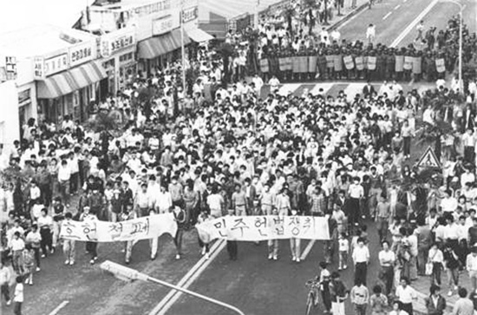
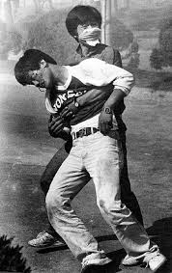
June Democratization Movement
(1987, Seoul)
(Lee Han-Yeol,
A univ. student who was hit by a tear-gas bullet while demonstrating for democracy at Yonsei Univ. in June 1987. His death in July led to rising resistance against the new military junta and for constitutional reform.)
July & August great workers' struggles for democratic unionization(1987, Ulsan)

Slide 8
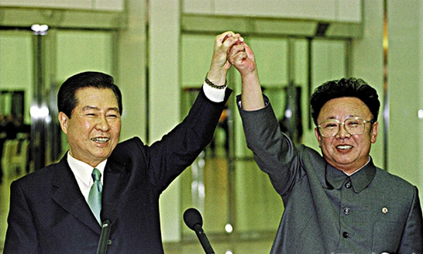
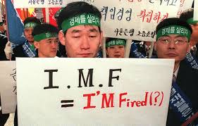
<97 regime> - Financial crisis (1997) -> neoliberal reforms -> increasing inequality + insecurity - longtime opposition/liberal leader Kim Dae-jung elected to be president (1997) -> societal liberalism rules - détente btw north and south korea
Kim Dae-Jung (SK) and Kim Jong-Il (NK)
at the First North-South Summit (2000, Pyong Yang)
Asian financial crisis and neoliberal burdens of the IMF conditionalities (1997, Seoul)

Slide 9
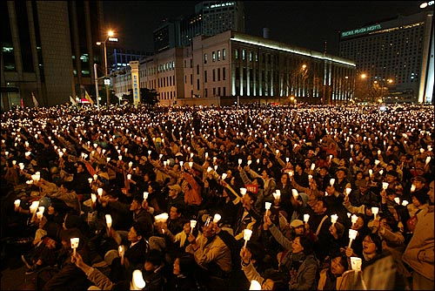
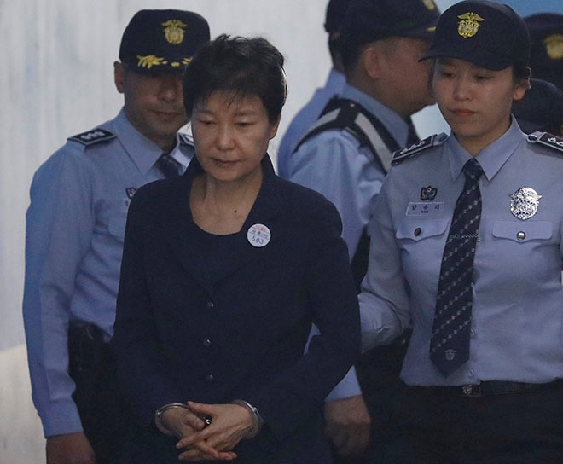
<2008 regime> - Conservative ruling party came back by two elections (2007, 2012) - conflicts btw N. and S. korea revived - media control, business-friendly anti-unionism backlash - power abuse (cronyism, bribery..) –> presidential impeachment (2017)
Candlelight vigil against the conservative government (2008)

Slide 10
4. Shaping and features of the ‘87 REGIME’
■ Shaping of the ‘87 regime’
- general Park Chung-hee’s death and general Chun Doo-Hwan’s coup in late 1979 → new military regime
- “Kwangju(Gwangju) Massacre/Uprising” (May 1980) => radicalizing students’ pro-democracy activism against the new military regime
- “June Democratization Movement” (1987): nationwide mass demonstrations by students and citizens against the new military regime → top politicians’ compromise → Constitutional Revision in late 1987 → revival of “direct presidential election” by people, which had been removed since the 1971 election.
- “July and August Great Workers’ Struggles” (1987): workers’ massive struggles for democratic unionization and improving working conditions → increase of unions and rising wages

Slide 11
■ Features of the ‘87 regime’ as the outcome of both activim and constitutional revision in 1987
- “Democratic transition” in 1987 and institutional stabilization (direct, fair and regular presidential election based on the new constitution: Presidency of a 5-year single term based on people’s direct voting, except for the case of presidential impeachment as happened in early 2017)
- Seven (regular) presidential elections since 1987 until late 2017
- Three ruling party shifts from conservative to liberal(1997), to conservative (2007), to liberal party (2017)
← Meeting S. Huntington’s formal criterion of democracy: two turn-over, i.e., shifts of ruling party to the opposition one and back again through elections

Slide 12
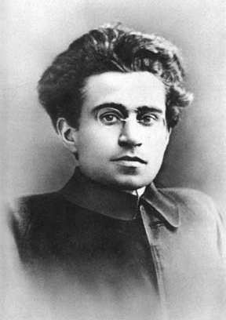
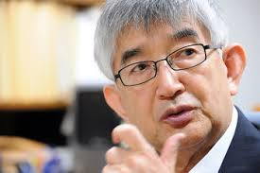
5. limitations of the ‘87 REGIME’
■ Evaluation of the 87 regime
- Democratic Institutionalization in 1987 as a “Passive revolution” (Gramsci) = conservative (+ liberal) elites’ political compromise with no institutionalization/participation of a working class-based political party, while massive social movements were mobilized in the course of the shift
➔ “Democracy without labor” (Choi Jang-Jip [political scientist, Korea Univ.] in his book <Democracy after Democratization>, published originally in 2002)
- This legacy of the 1987 compromise still affecting political courses in South Korea

Slide 13
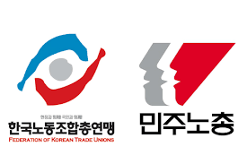
■ Three limitations of the ‘87 Regime’ and Alternatives
1. Absence of the detailed blueprint for socio-economic democracy, or even a reverse course (inequality, insecurity) under the pressure of neoliberalization (since 1997, such as financial opening and expansion, privatization, de-regulation, employment flexibility etc.)
→ needing post-liberal/progressive policies against neoliberalism (universal welfare-state, controlling business power abuse, active labor market policy, co-determination in workplace, basic income…)

Slide 14
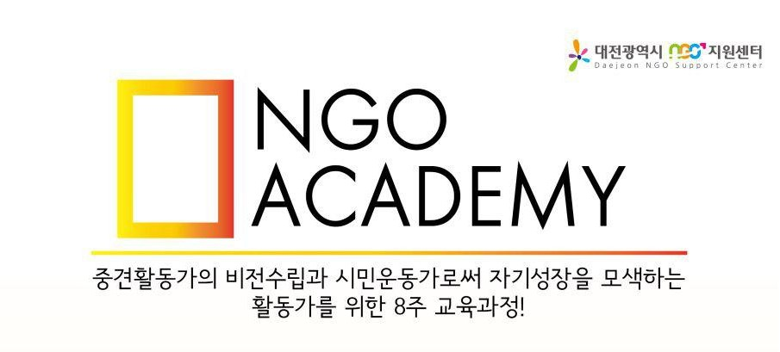
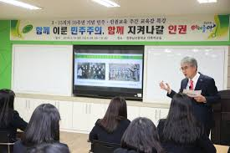
■ Three limitations of the ‘87 Regime’ and Alternatives (Cont.)
2. limitations of the democracy paradigm itself, which has been held by the liberal/democratic politicians (since 1987): they have thought that if they take power, having institutional power, it could mean that people have democracy (= power-taking approach to democracy)
→ focusing not only on political ruling party turn-over for having liberal government, but also on the democratic reproduction of state apparatuses, businesses at the macro level and of life-world and individual subjects at the micro-level (practicing and realizing democratic norms in daily life are important)

Slide 15
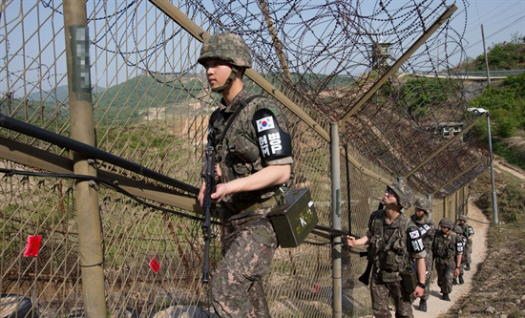
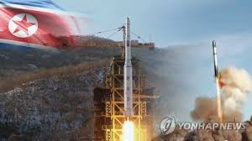
■ Three limitations of the ‘87 Regime’ and Alternatives (Cont.)
3. limitations of stabilizing peaceful relations btw N. + S. Korea under the national-division system since the Cold War era.
→ giving up a top-down/hasty approach to peace-making, but at the bottom level accumulating a long-term trust in the peaceful future in the Korea Peninsula as well as in Northeast Asian region.

Slide 16
THANK YOU!

